Slide 1
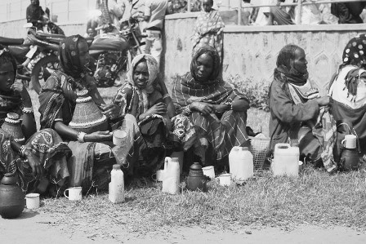
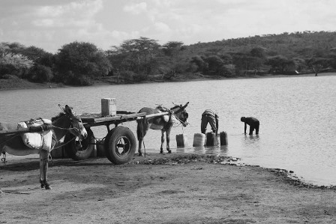
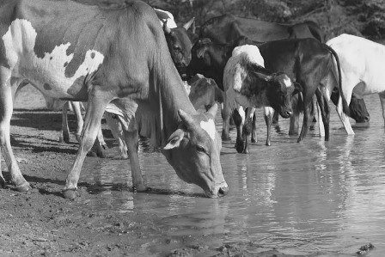
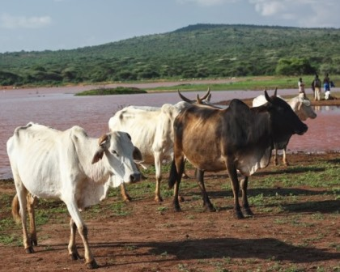
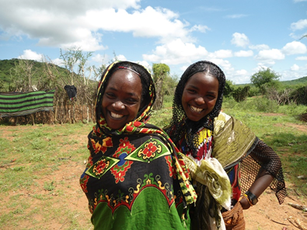
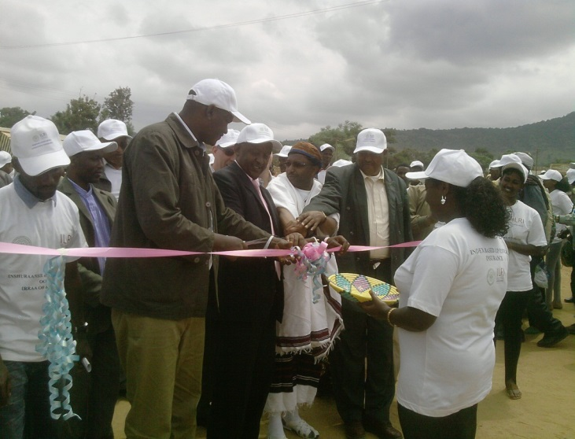
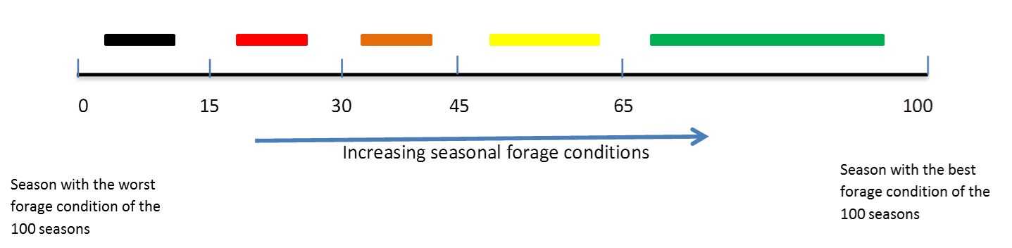
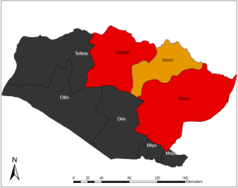
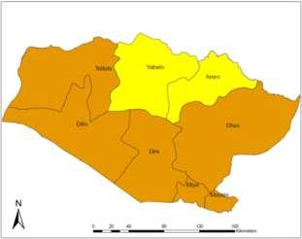
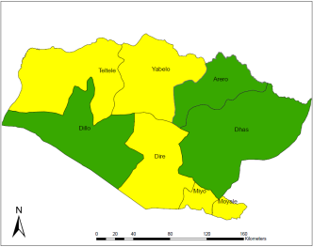



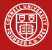
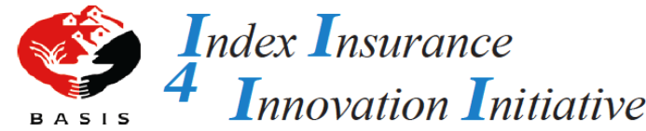
Creating Resilience through Index Based Livestock Insurance (IBLI)
INSIGHTS FROM ETHIOPIA
Motivation
Index Based Livestock Insurance (IBLI)
    Drought is a covariate shock that erodes livestock assets making households fall into a poverty trap
    Poor pastoralists have few available strategies to manage and cope with livestock mortality risk
    Over 300,000 livestock deaths recorded due to drought in the Borana region, which is estimated at US$ 85 million as of July 2011
    Lack of credit and insurance markets in infrastructure-deficit environments has rendered traditional risk sharing arrangements weakened and insufficient
Motivation
    Designed to protect pastoralist against drought-related livestock losses
    Contract holders receive payouts when forage condition deteriorates blow a certain historical level
    Payouts are calculated automatically and there are no claims to file - hence solving issues of moral hazard and adverse selection.
    Failure of governments and international aid agencies in delivering timely and adequate relief to prevent adverse impact of drought
    Hence the effort to developing risk management instruments that are both feasible, commercially viable and potentially effective in reducing poor pastoralists’ uninsured risk exposure
How the Index Works
    Index is calculated using a measure of pasture availability recorded by satellites, called the Normalized Differenced Vegetation Index (NDVI).
    Pastoralists purchase an annual contract with possibility of payout in either March or October
    Payouts are made when the forage situation is below the worst 15 percentile
Key Activities in Ethiopia
Green | Good forage availability that represents above 65 percentile over a long period. This is above normal and stable forage condition.
Yellow | Forage condition falls between 45 to 65 percentiles. The forage situation is positive but consistently worsening.
Orange | Forage condition is between 30 and 45 percentile. The division in question is under considerable stress but not yet serious.
Red | Forage condition is between 15 – 30 percentiles. Drought situation is serious but not yet classified as severe. Indemnity payout will not be triggered.
Black | Severe drought condition. Forage condition represents worst 15 percentile. Indemnity payout will be triggered if conditions persist throughout the season up to the potential payout period.
    Contract designing and index development by ILRI and Cornel University
    Manuals and education material created for all stakeholders involved in the implementation process
    Dissemination of product information through workshops and training programmes
    Cross-border trips of elders of four ethnic groups to Marsabit for product- awareness creation
    Oromia Insurance Company sc. (OIC) has been the underwriting partner
    Launch of sales in collaboration with OIC, regional government Borana zone, ILRI and Cornell University
    405 policies have been sold through local MFIs and co-operatives acting as distribution channels in the January/February 2014 sales window
    Further identification of innovative distribution channels and extension methods are underway to scale up the process of IBLI uptake
Key Collaborators
Oct 2009
March 2009
March 2014
    Further information: https://livestockinsurance.wordpress.com/category/about-ibli/

